Slide 1
Anodiam Teacher App: Wireframes
Link: https://github.com/anodiamadm/Docs > ProjectExecution > BA > SpecsWireframes
Version | Editor | Reviewer | Date | Note
1.0 | AC | AM | 26/11/2020 | Teacher App wireframes
2.0 | AC | AM | 22/02/2021 | Updated with screen prints from real app.

Slide 2
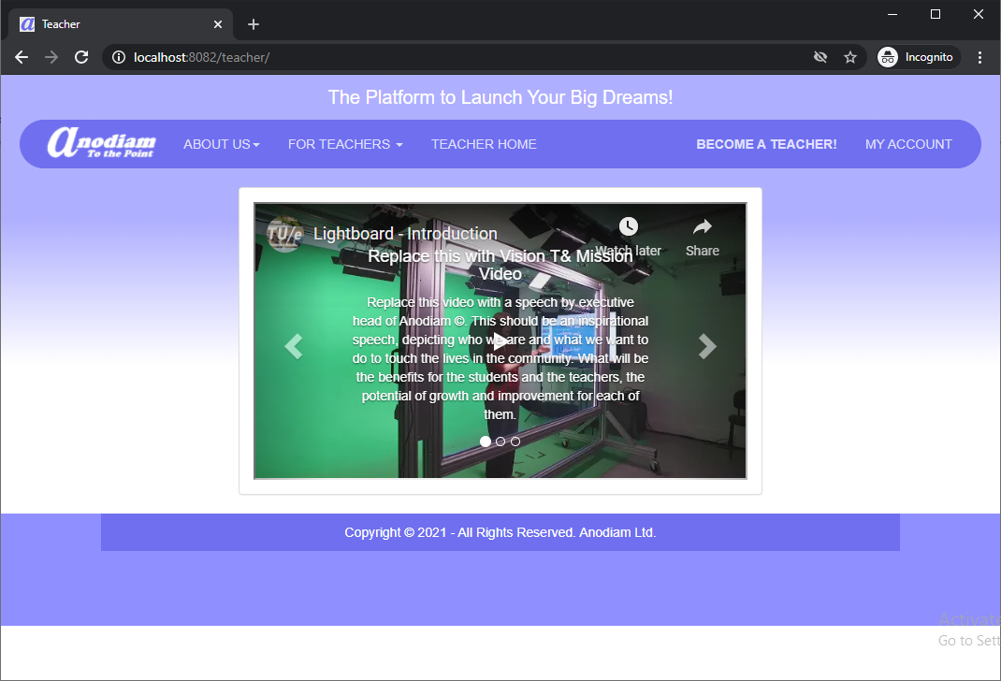
Teacher App: Home Page
Link: https://anodiam.com/teacher/

Slide 3
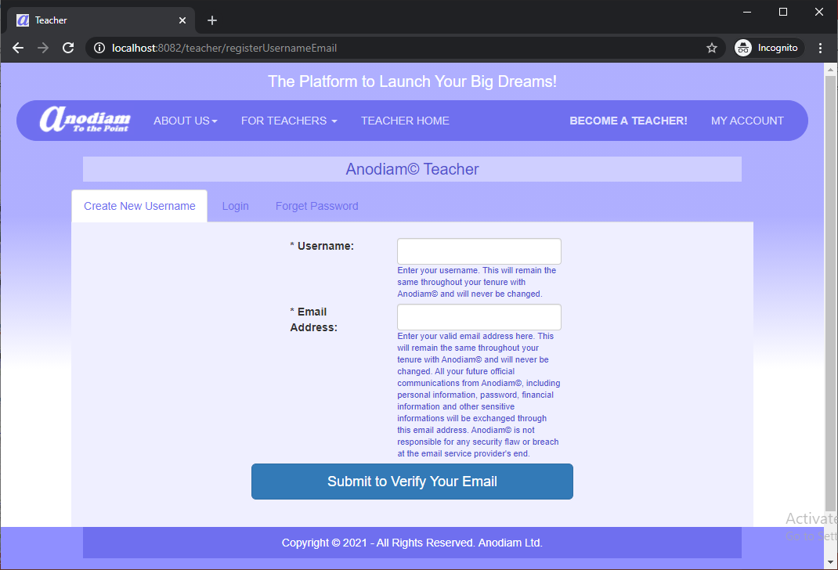
Teacher App: Create New Username Page
Link: https://anodiam.com/teacher/registerUsernameEmail

Slide 4
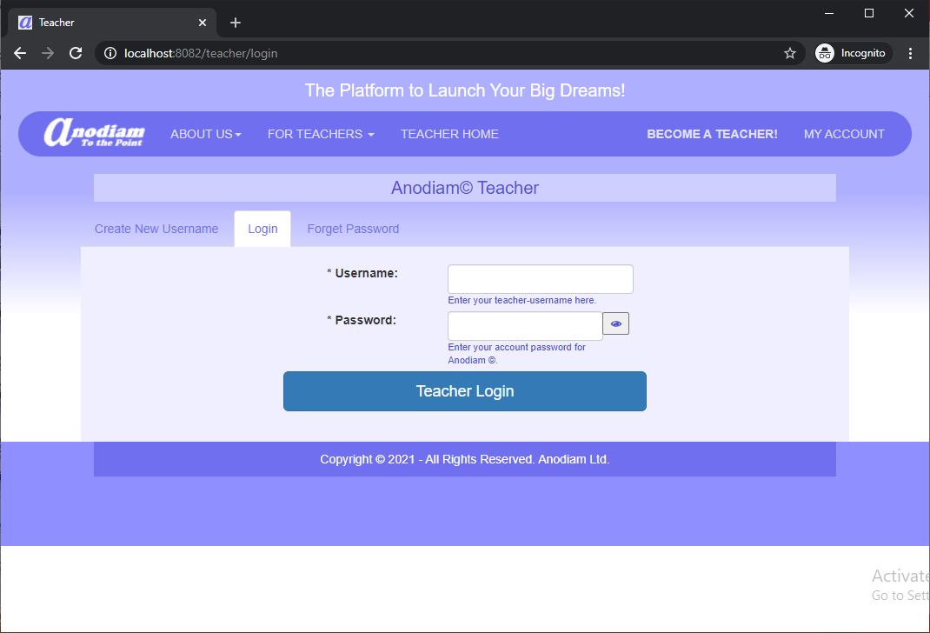
Teacher App: Login Page
Link: https://anodiam.com/teacher/login

Slide 5
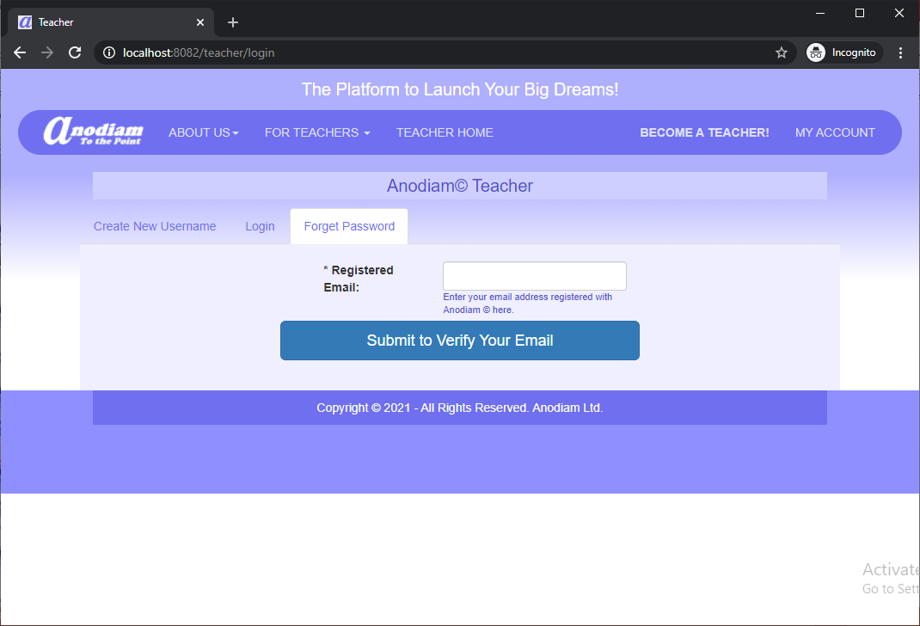
Teacher App: Forget Password
Link: https://anodiam.com/teacher/login

Slide 6
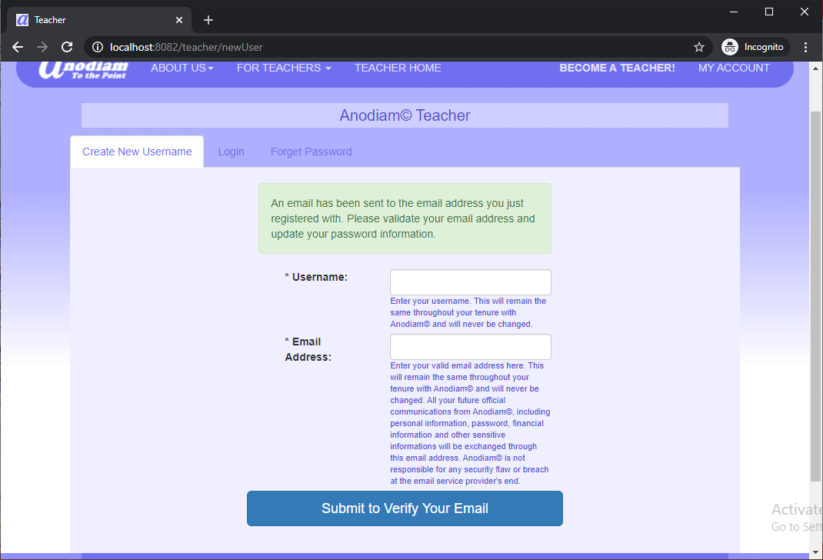
Teacher App: Create New Username (Email Sent) Page
Link: https://anodiam.com/teacher/newUser/

Slide 7
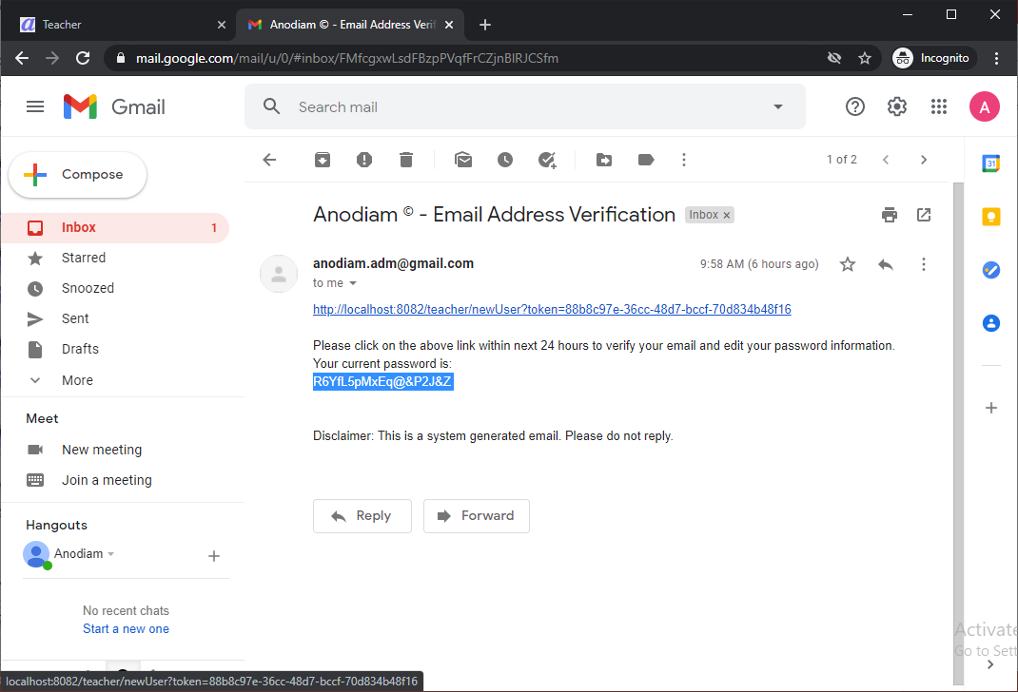
Teacher App: New User Email Verification
Link: user’s mailbox

Slide 8
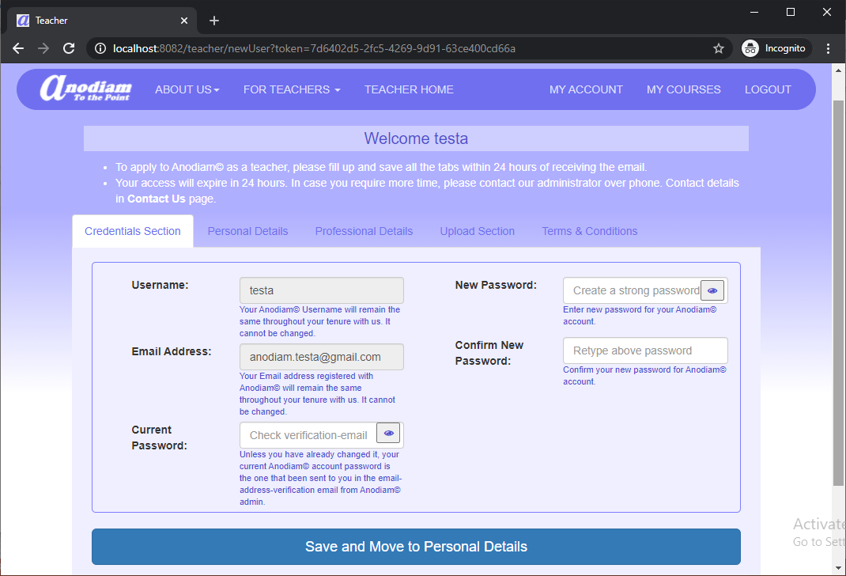
Teacher App: New User Page, Credentials Section Tab
Link: https://anodiam.com/teacher/newUser?token=hex-token

Slide 9
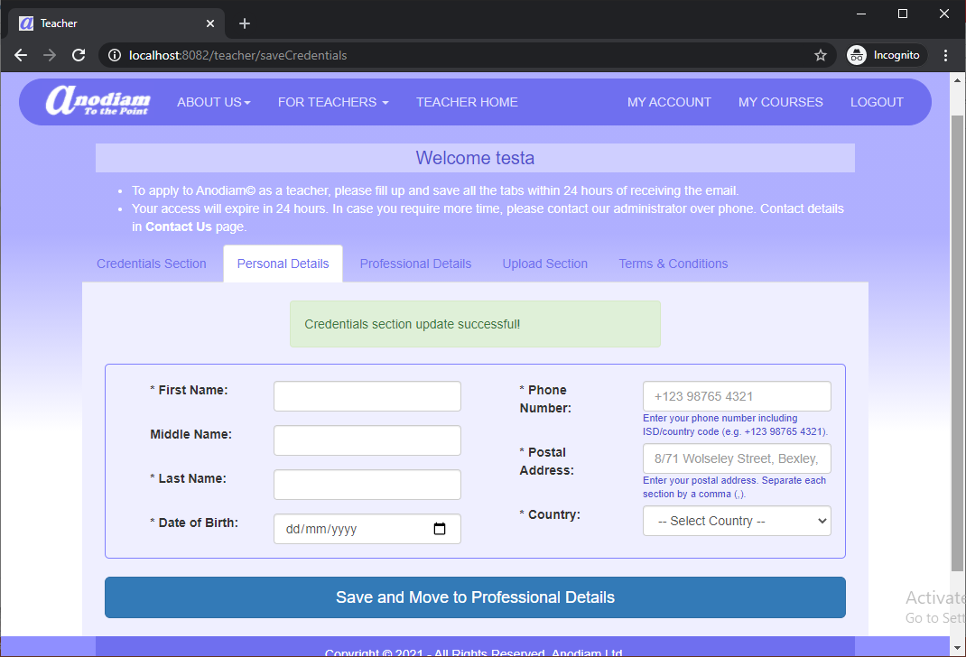
Teacher App: New User Page, Personal Details Tab
Link: https://anodiam.com/teacher/saveCredentials

Slide 10
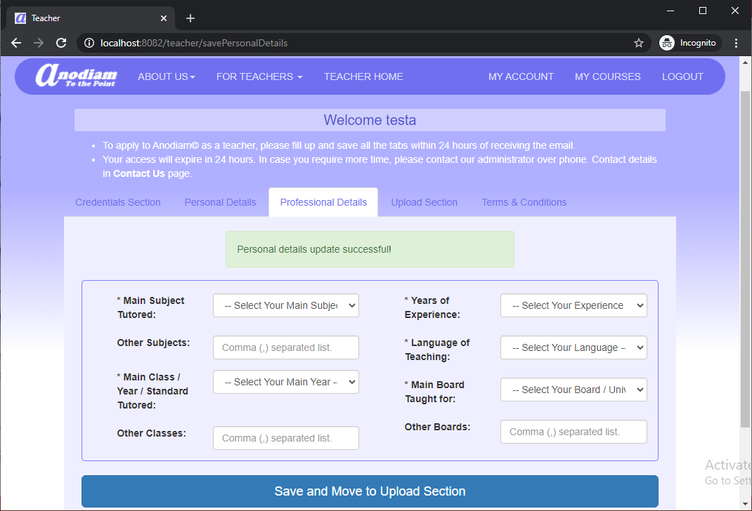
Teacher App: New User Page, Professional Details Tab
Link: https://anodiam.com/teacher/savePersonalDetails

Slide 11
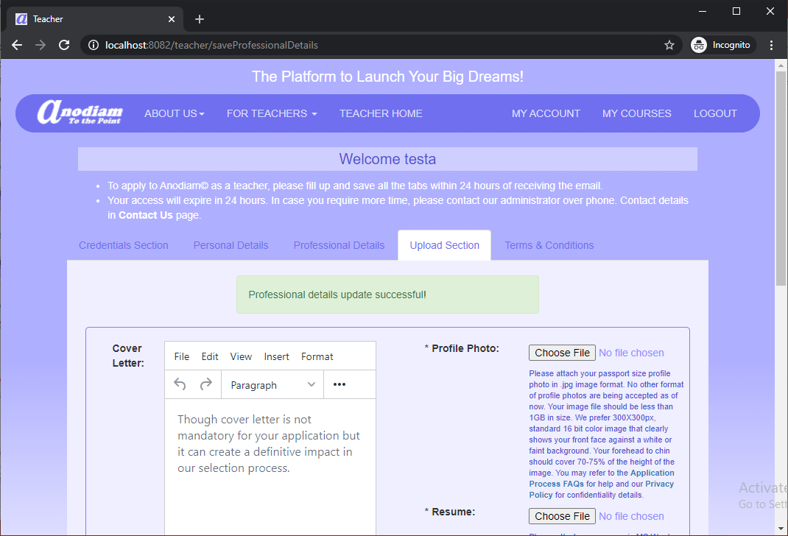
Teacher App: New User Page, Upload Section Tab
Link: https://anodiam.com/teacher/saveProfessionalDetails

Slide 12
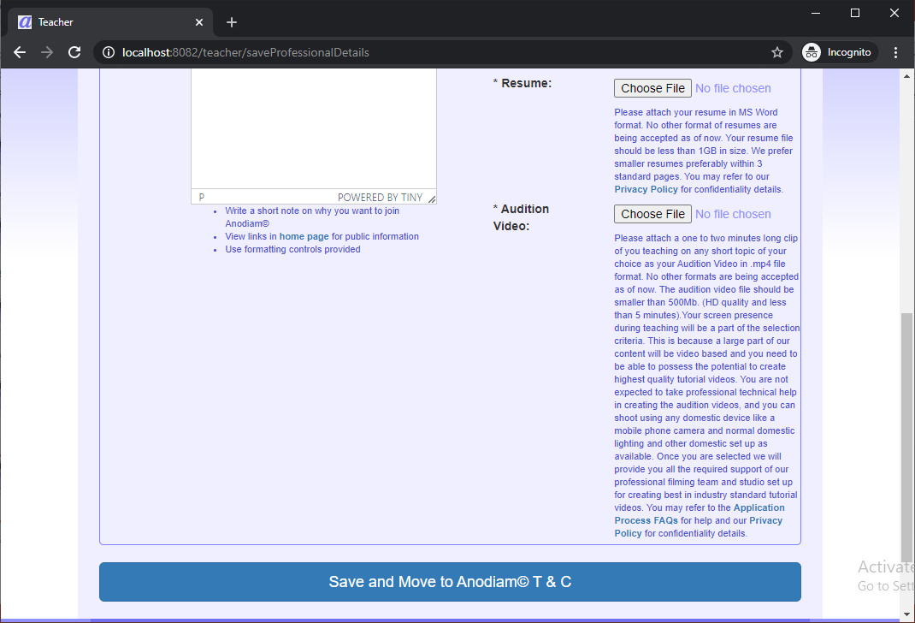
Teacher App: New User Page, Upload Section Tab (Bottom)
Link: https://anodiam.com/teacher/saveProfessionalDetails

Slide 13
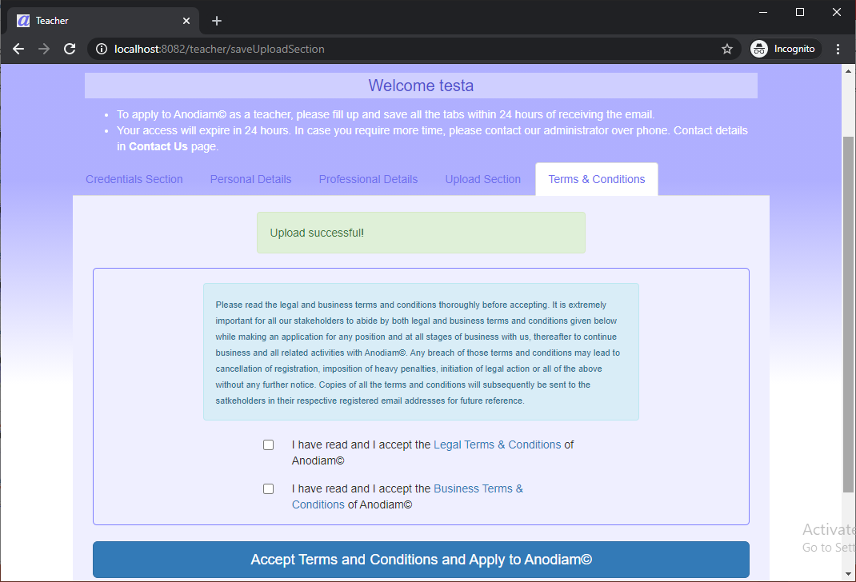
Teacher App: New User Page, T&C Tab
Link: https://anodiam.com/teacher/saveUploadSection

Slide 14
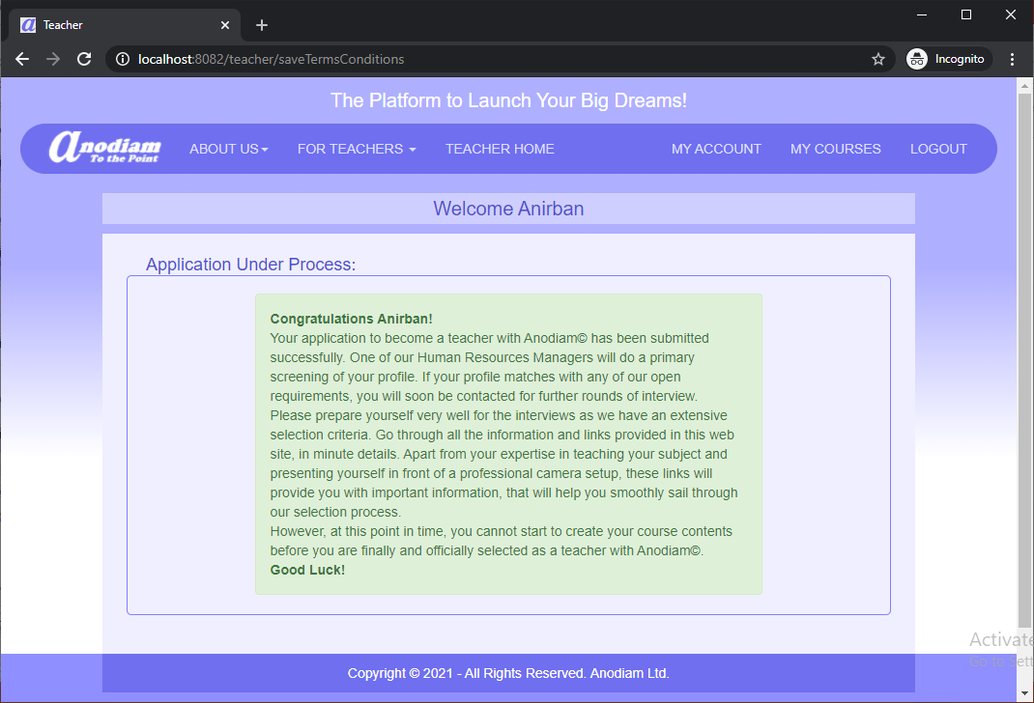
Teacher App: Application Submission Confirmation Page
Link: https://anodiam.com/teacher/saveTermsConditions myProfile myCourses

Slide 15
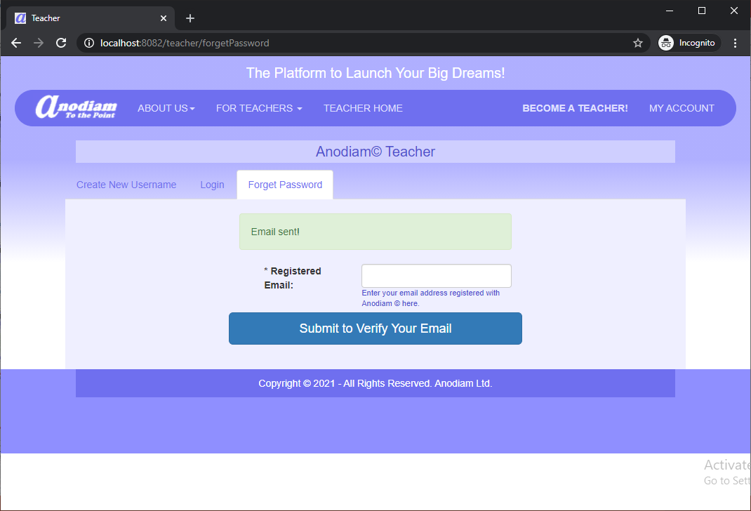
Teacher App: Forget Password (Email Sent)
Link: https://anodiam.com/teacher/forgetPassword

Slide 16
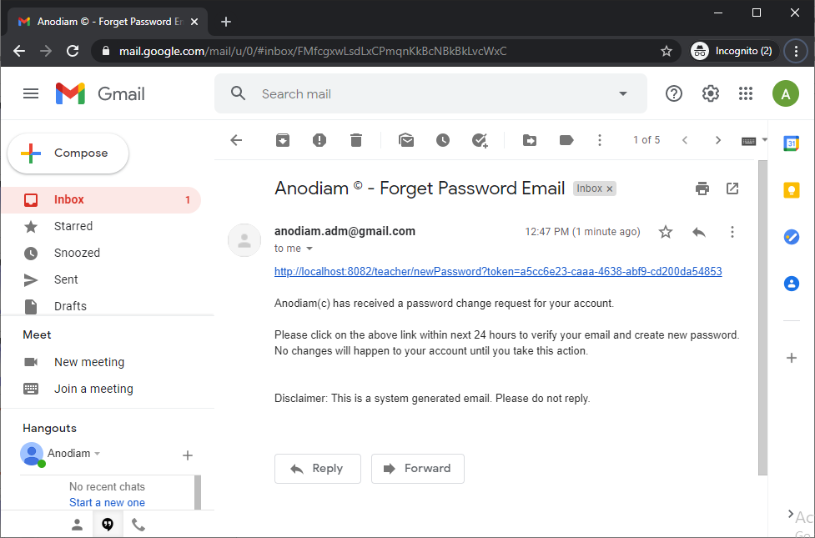
Teacher App: Forget Password Email Verification
Link: user’s mailbox

Slide 17
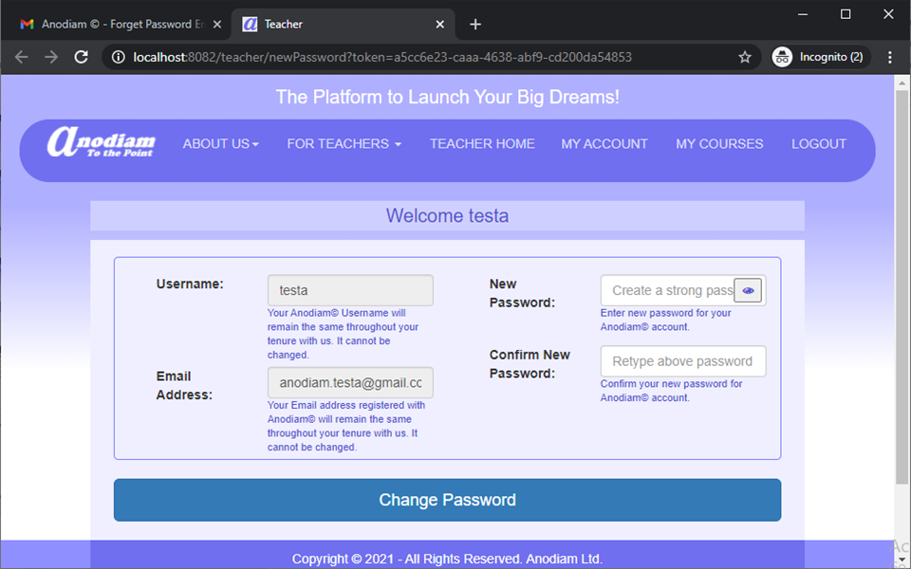
Teacher App: Forget Password (Create New Password)
Link: https://anodiam.com/teacher/newPassword?token=hex-token

Slide 18
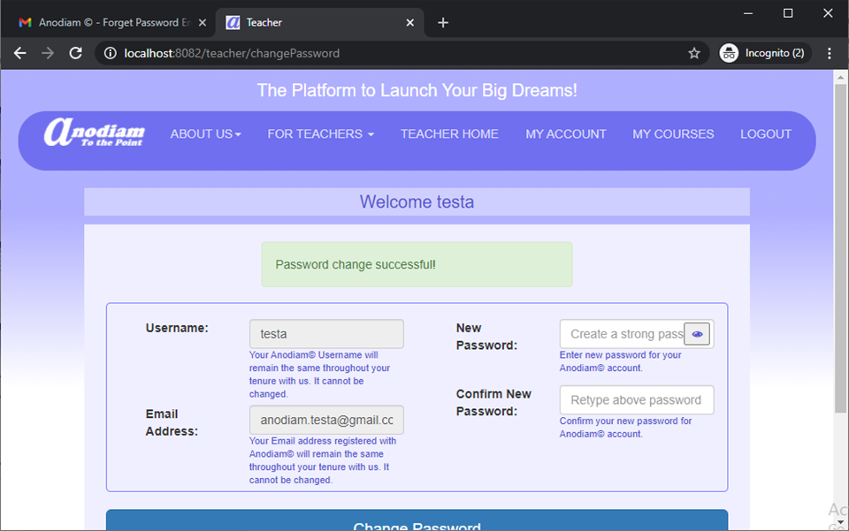
Teacher App: Forget Password (Create New Password)
Link: https://anodiam.com/teacher/changePassword

Slide 19
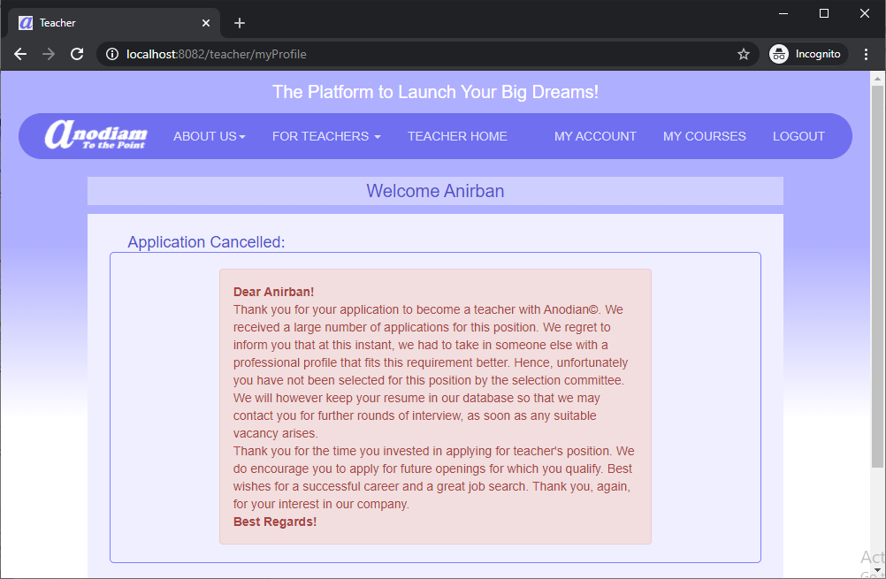
Teacher App: Login (Teacher Application Rejected by Anodiam)
Link: https://anodiam.com/teacher/myProfile myCourses

Slide 20
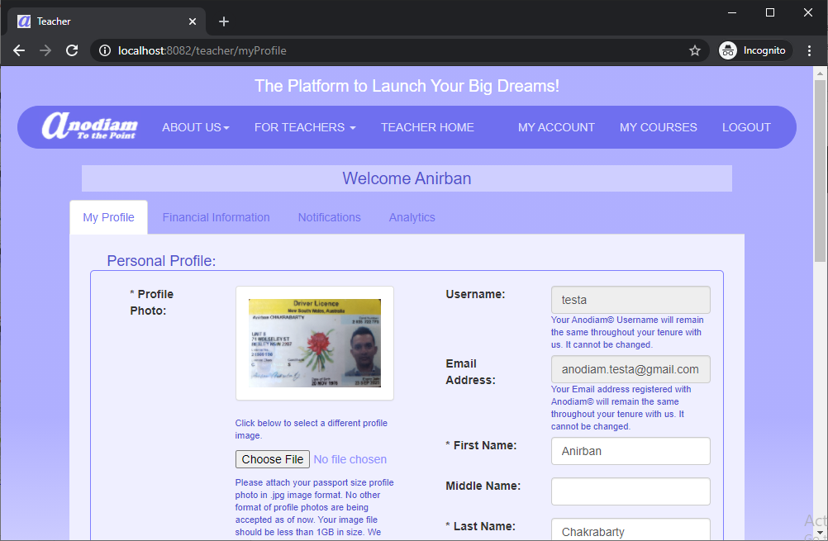
Teacher App: My Profile (Teacher Application Approved by Anodiam)
Link: https://anodiam.com/teacher/myProfile

Slide 21
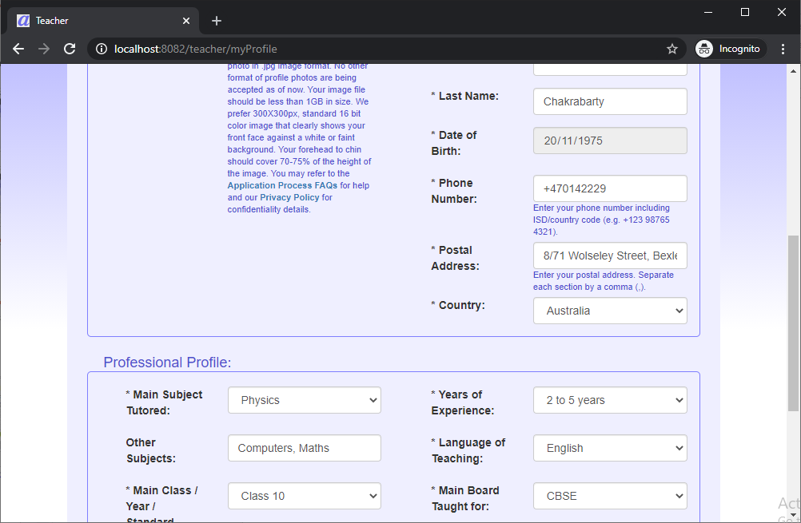
Teacher App: My Profile (Teacher Application Approved by Anodiam)(Bottom - 1)
Link: https://anodiam.com/teacher/myProfile

Slide 22
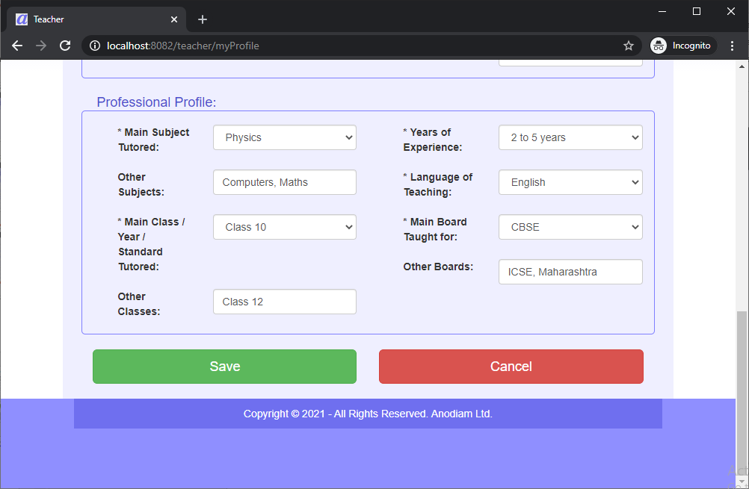
Teacher App: My Profile (Teacher Application Approved by Anodiam)(Bottom - 2)
Link: https://anodiam.com/teacher/myProfile

Slide 23
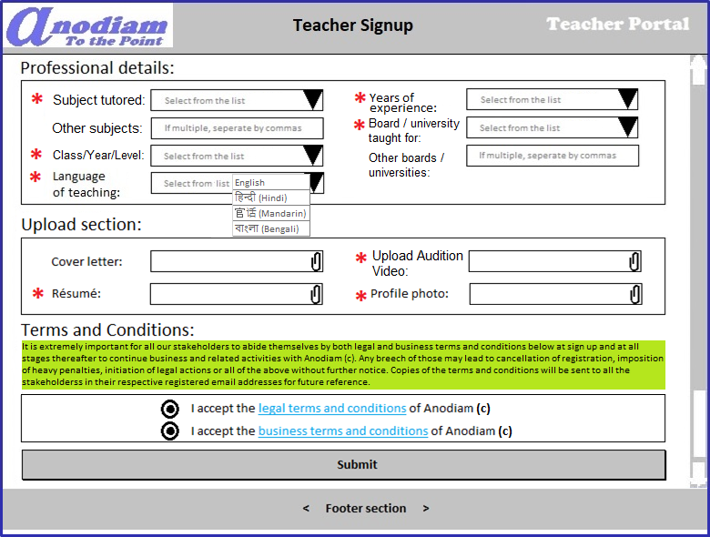
Teacher App: Signup – Teacher Signup page (continued)
Link: https://anodiam.com/teacher/signup

Slide 24
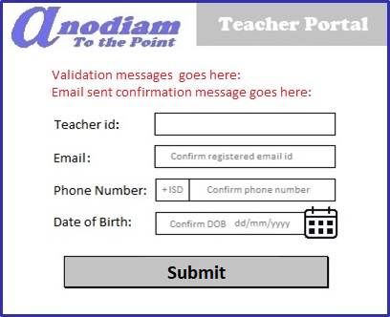
Teacher App: Signup – Forget / Change Password page
Link: https://anodiam.com/teacher/changepassword/{userid}

Slide 25
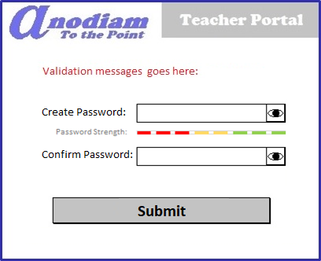
Teacher App: Signup – Create New Password page
Link: https://anodiam.com/teacher/createpassword/{userid}

Slide 26
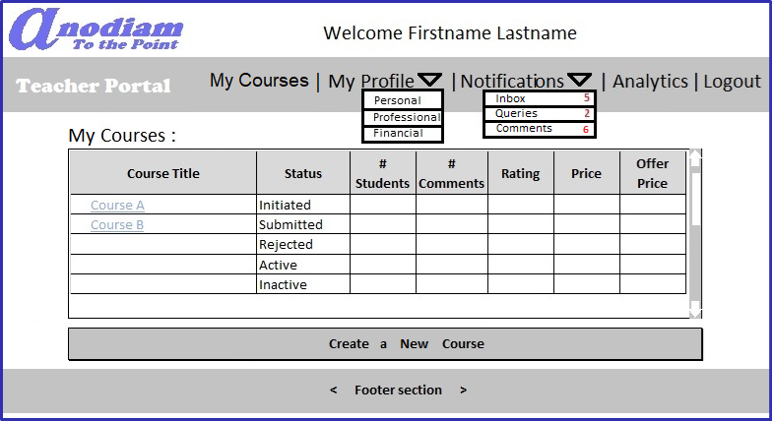
Teacher App: My Teacher Home / View All Courses page
Link: https://anodiam.com/teacher/myhome/{userid}

Slide 27
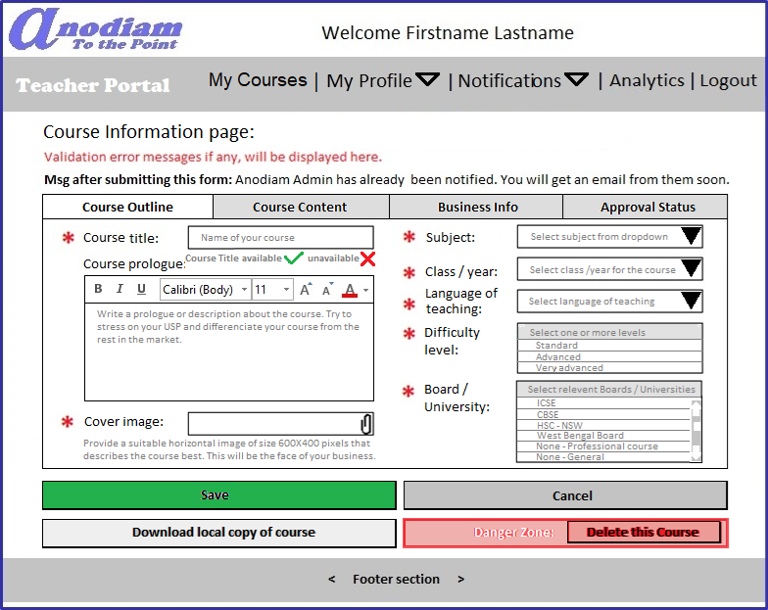
Teacher App: Create Course page Outline tab
** Only non-active courses can be deleted
Link: https://anodiam.com/teacher/addnewcourse

Slide 28
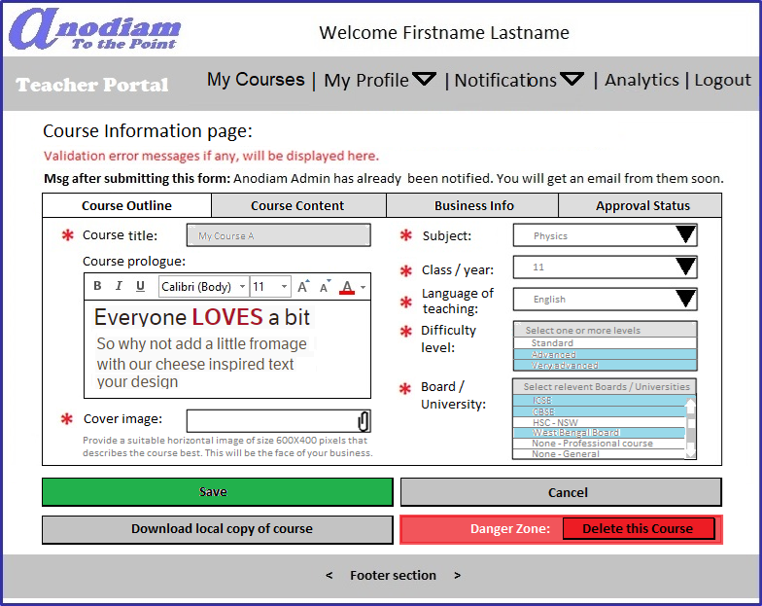
Teacher App: View, Update Course page Outline tab
** Only non-active courses can be deleted
Link: https://anodiam.com/teacher/course/{courseid}

Slide 29
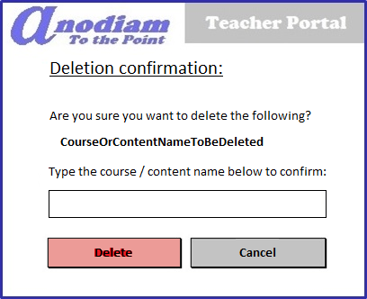
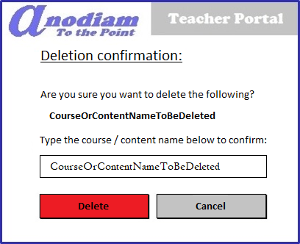
Teacher App: Confirm Deletion dialogue
** Only non-active courses can be deleted
Link: https://anodiam.com/teacher/deletecourse/{courseid}
On confirmation of Course / Content name
Delete button is enabled

Slide 30
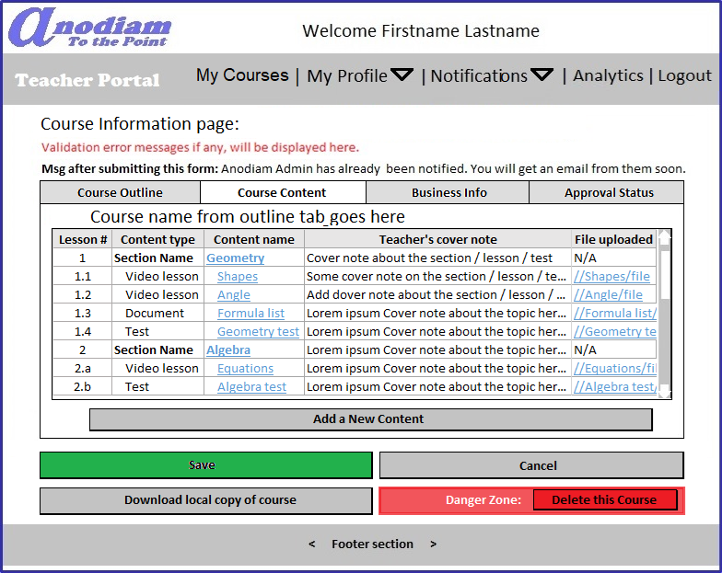
Teacher App: Create / Edit Course page Content tab
Link: https://anodiam.com/teacher/addnewcourse
https://anodiam.com/teacher/course/{courseid}

Slide 31
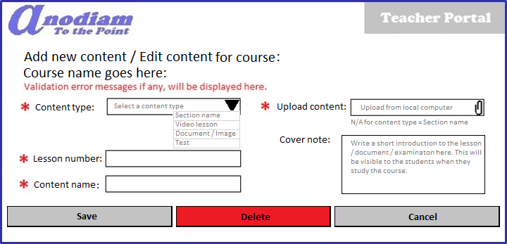
Teacher App: Content Detail (Add / Update / Delete) dialogue
Link: https://anodiam.com/teacher/addnewcontent
https://anodiam.com/teacher/content/{contentid}

Slide 32
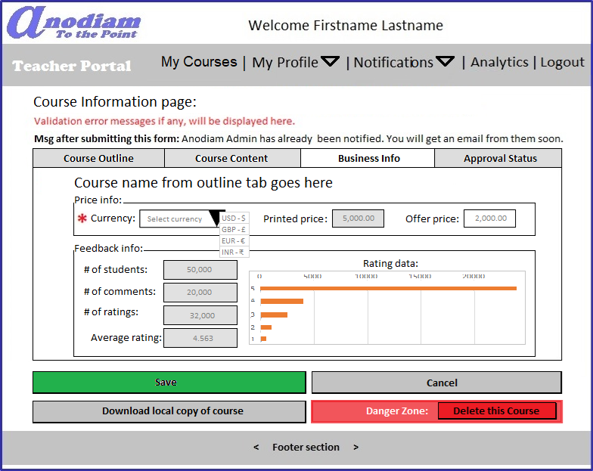
Teacher App: Create / Edit Course page Business Info tab
Link: https://anodiam.com/teacher/addnewcourse
https://anodiam.com/teacher/course/{courseid}

Slide 33
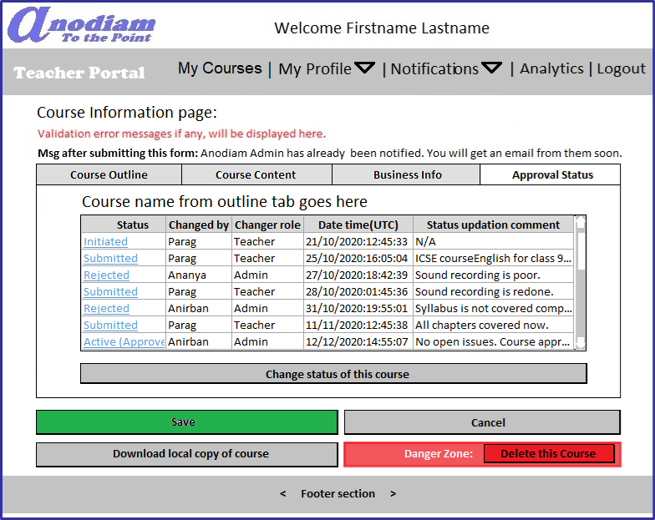
Teacher App: Create / Edit Course page Approval Status tab
Link: https://anodiam.com/teacher/addnewcourse
https://anodiam.com/teacher/course/{courseid}

Slide 34
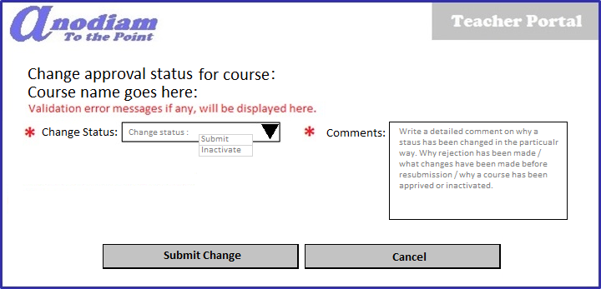
Teacher App: Approval Status dialogue
Link: https://anodiam.com/teacher/addnewstatus

Slide 35
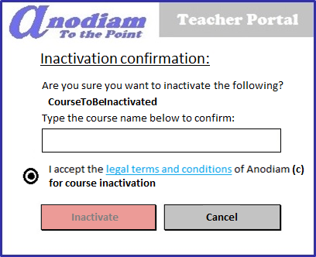
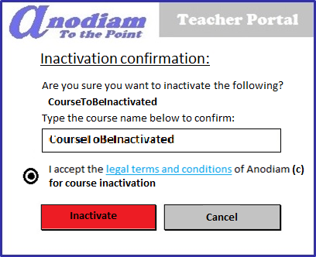
Teacher App: Confirm Course Inactivation dialogue
** Only active courses can be inactivated
Link: https://anodiam.com/teacher/inactivatecourse/{courseid}
On confirmation and T&C acceptance, Inactivate button is enabled

Slide 36
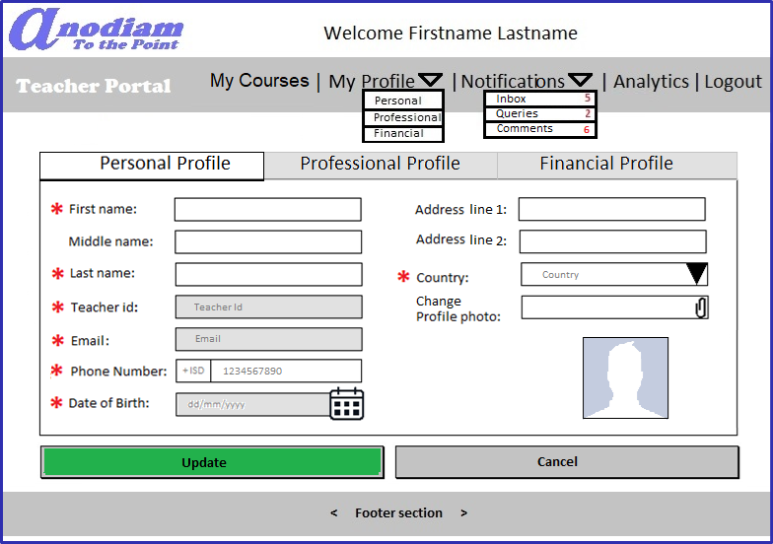
Teacher App: Personal Profile page
Link: https://anodiam.com/teacher/myprofile/{userid}

Slide 37
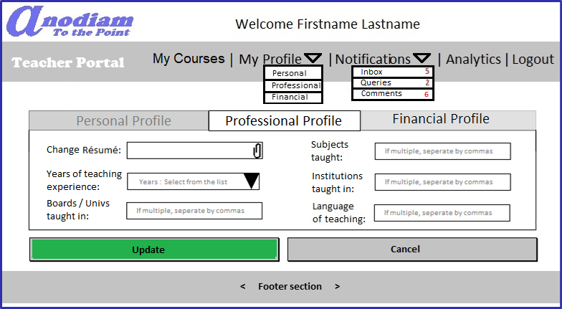
Teacher App: Professional Profile page
Link: https://anodiam.com/teacher/myprofile/{userid}

Slide 38
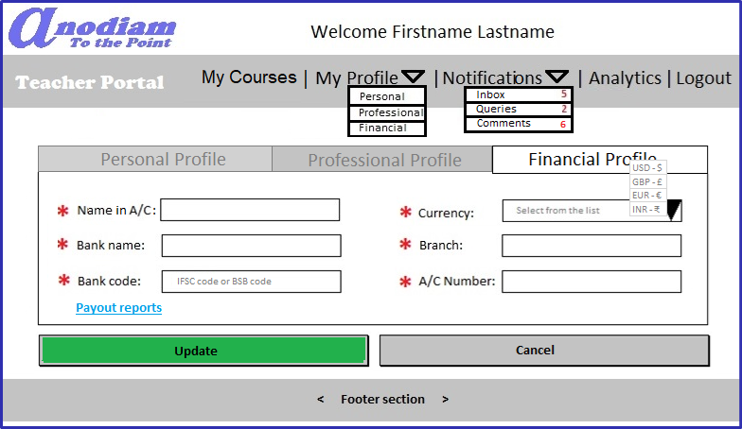
Teacher App: Financial Profile page
Link: https://anodiam.com/teacher/myprofile/{userid}

Slide 39
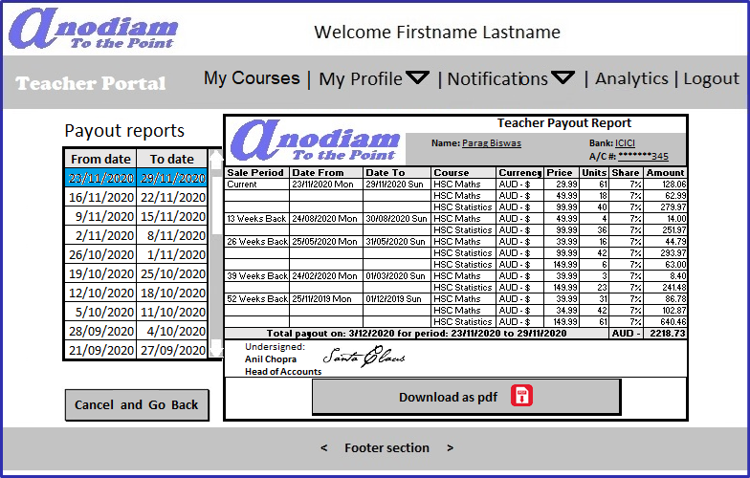
Teacher App: Payout Reports page
Link: https://anodiam.com/teacher/payouts/{userid}

Slide 40
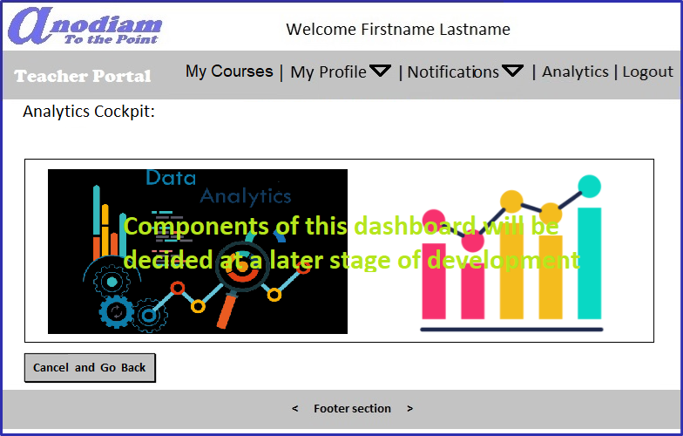
Teacher App: Analytics page
Link: https://anodiam.com/teacher/analytics/{userid}

Slide 41
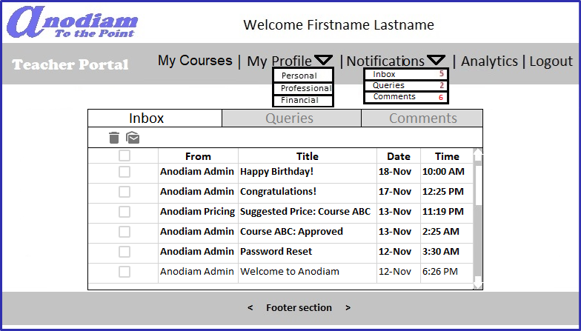
Teacher App: Notifications > Inbox page
Link: https://anodiam.com/teacher/messages/{userid}

Slide 42
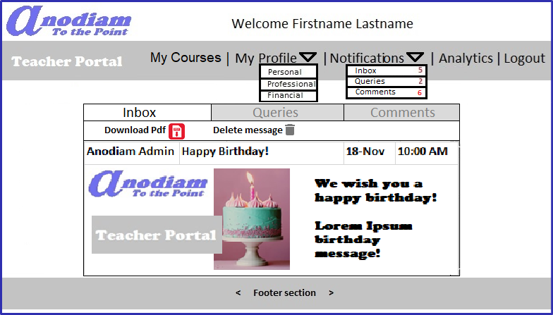
Teacher App: Notifications > Inbox > Message page
Link: https://anodiam.com/teacher/message/{messageid}

Slide 43
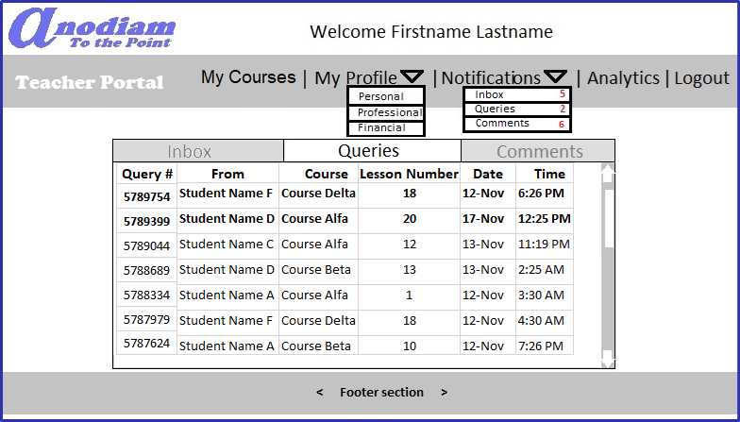
Teacher App: Notifications > Queries page
Link: https://anodiam.com/teacher/queries/{userid}

Slide 44
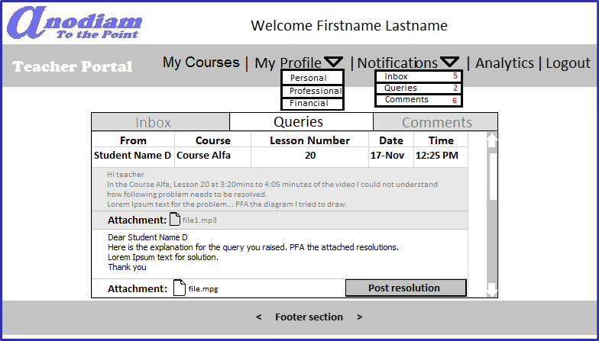
Teacher App: Notifications > Query > Resolution page
Link: https://anodiam.com/teacher/query/{queryid}

Slide 45
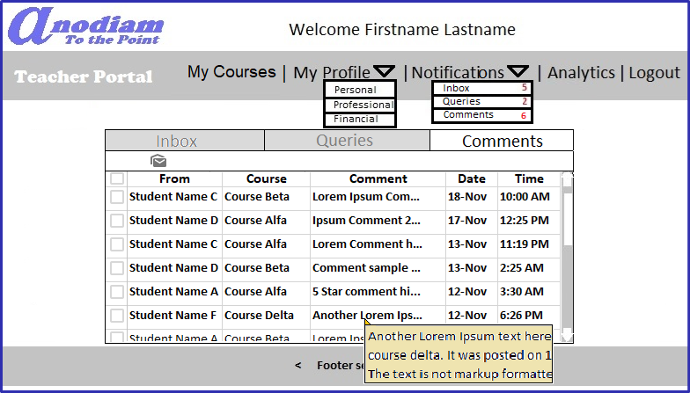
Teacher App: Notifications > Comments page
Link: https://anodiam.com/teacher/comments/{userid}

